Slide 1

CT6018 PITCH
Joe Mason

Slide 2

Who are we? Joe’s Games
Limited company founded by Joe Mason
Indie game studio producing games for mobile devices
Owner & 1 employee, outsourcing for additional development
Based in Cheltenham, Gloucestershire
Content available worldwide on a range of mobile devices
Notes:
What is being outsourced and when – big updates, big events etc
Hire marketing analyst to keep track of finances, attention of game, where money is and isn’t coming from, good and bad events etc
Rent servers based around the world such as America and China, language and legal stuff for those regions

Slide 3
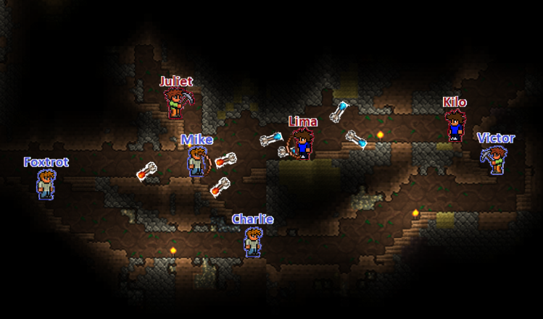
Product Overview
OutDig
Mine, fight and build to outplay your opponents in fast-paced, real-time battles
Genre
Casual, Action
Type
Platformer, Sandbox
Target Audience
Casual & competitive players, aged 7 upwards
Financials (end of 2026)
~£340,000 total revenue
~£225,000 total cost
Notes:
Unranked for strictly casual players, ranked for more competitive players
Total costs through marketing, salaries, software etc
Total revenue through In App Purchases, Ad Revenue
Leaving a profit of x at the end of 4 years from development beginning

Slide 4

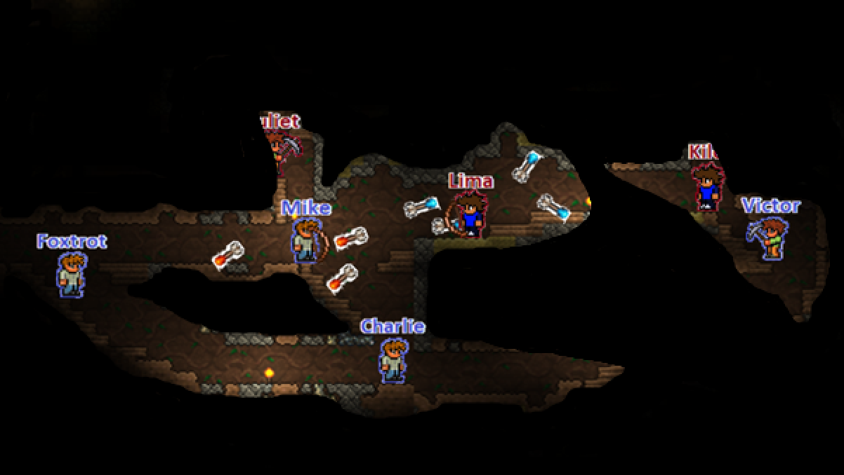
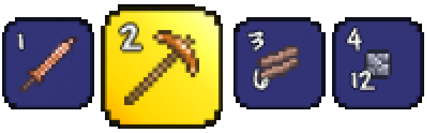





Notes:
UI elements in corners
Melee, ranged weapons, pickaxe, wood & stone blocks
Open inventory via backpack icon to manage ores
Menu for audio, UI layouts, reporting, quitting
Team shared line of sight player vision

Slide 5
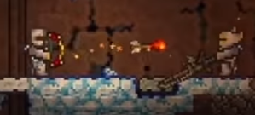
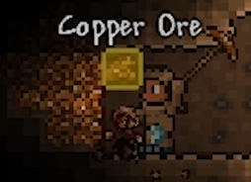
Core Mechanics
Fighting
Sword for Melee
Bow for ranged
Physics based
Smooth
Mining
Dig through environment
Sell scrap for gold
Obtain enough ores to unlock better equipment
Notes:
Focus on fighting mechanics – physics based, accurate on all players devices, fluid
Dig through environment with pickaxe, collecting ores, dirt, cobblestone.
Sell for gold, ores also add to team’s total for unlocking equipment with that metal

Slide 6
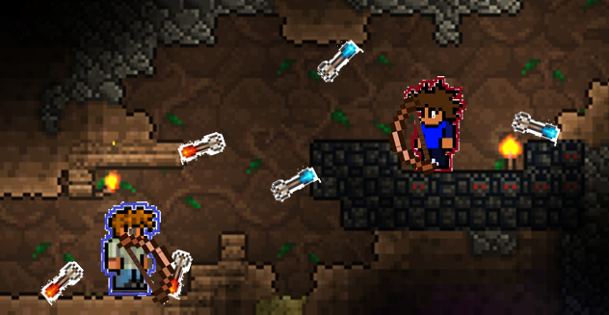
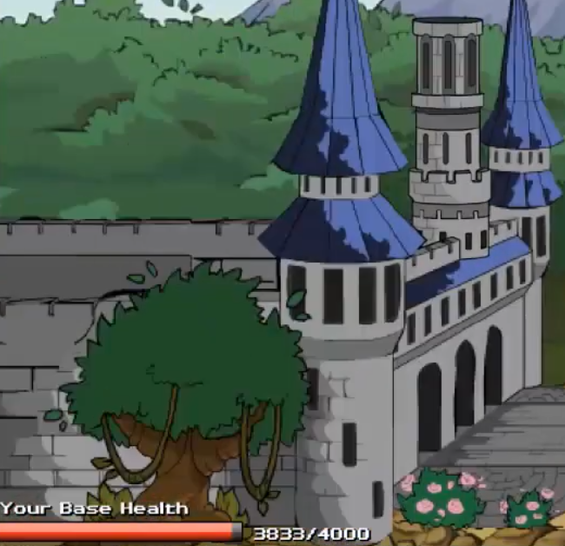

Core Mechanics
Building
Buy building blocks for coins
Cost determines strength
Block off tunnels
Build walls to setup a defense
Gameplay Objective
Smaller missions for rewards
Main objective is win condition of inner game loop
Capture the flag or Siege game modes
Notes:
Use your coins to buy building blocks, wooden blocks are cheap and hardened stone blocks are expensive
Use them strategically, you could build walls to give yourself an advantage in fights or block off unwanted tunnels
Takes small amount of time to place and cancelled if you move, so cannot be abused
Small missions that are random every game, e.g. accumulate 100 gold, get 10 kills, steal a flag
Main objective of the inner game loop depends on mode – steal their flag as many times as you can in CTF, or destroy their base first in siege

Slide 7


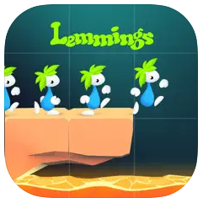
Competition
Brawlhalla
2020 - Blue Mammoth Games
Terraria
2013 - Re-Logic
Lemmings
2018 - Exient
10m total downloads (free)
963k new downloads (2021)
£268,000 revenue (2021)
9.3m total downloads (£4.59)
228k new downloads (2021)
£452,000 revenue (2021)
5m total downloads (free)
720k new downloads (2021)
£278,000 revenue (2021)
Notes:
Figures from reflection.io & appstore

Slide 8
Unique Selling Point
Gap In Market
Combines features and mechanics from competitor's products
Existing Audience
Competitors already have a large fanbase, OutDig does not directly compete
Wide Audience
Strictly casual and more competitive players both have applicable modes
Multiple Revenue Streams
Ads to open loot boxes, IAP for loot boxes, currencies, subscriptions
High User Retention
Players can play the game for free, without ads, increasing retention rate

Slide 9
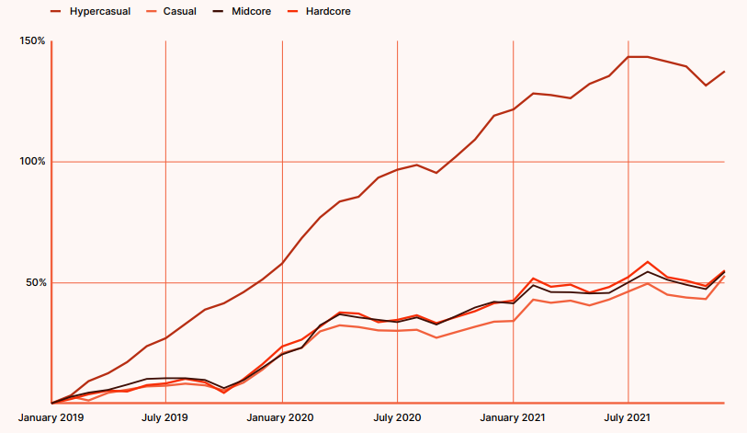
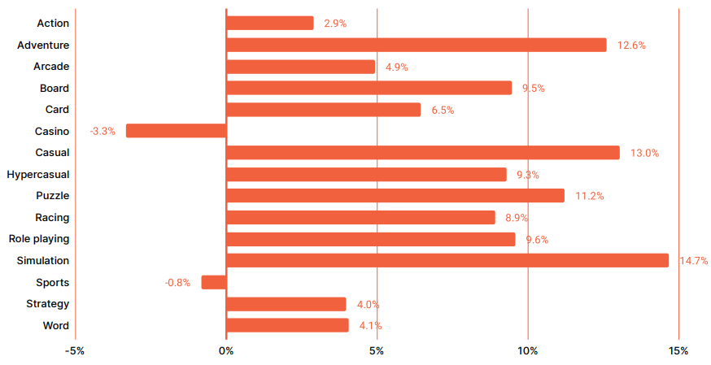
Market Potential - Games published
Number of Unity games
published per genre
(2022 to 2021)
Casual up 53%
Midcore up 54%
Hardcore up 55%
Hyper-casual up 137%
Action up 2.9%
Casual up 13.0%
Notes:
Unity Gaming Report 2022
Total games in casual genre up 53% from 2020 to 2022

Slide 10
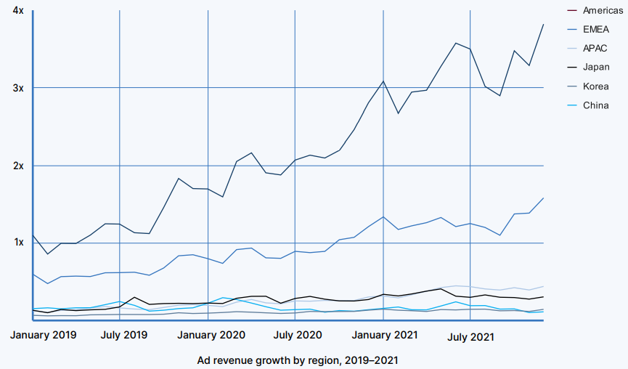
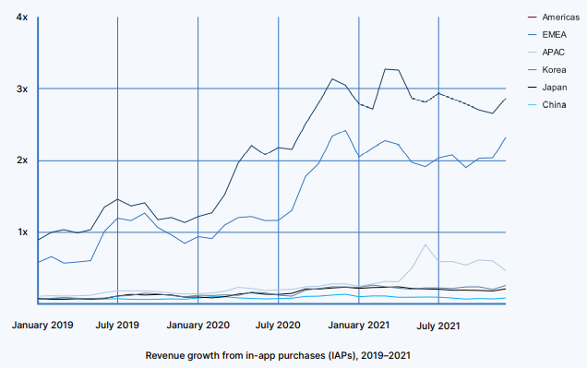
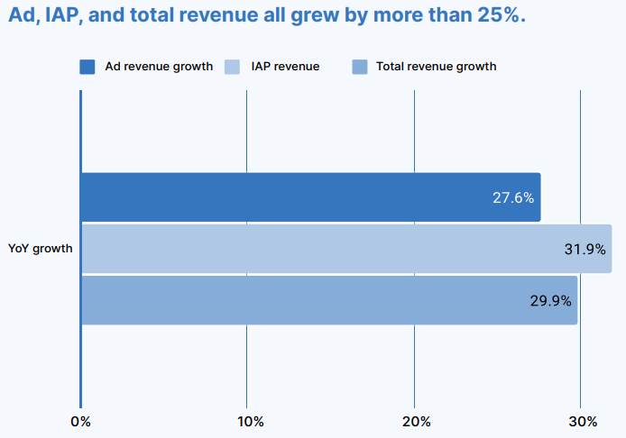
Market Potential - Revenue
Revenue from in-app purchases and advertisements across regions
(2020 to 2021)
Total revenue grown by 30%
EU Ad revenue grown by 52%
EU IAP revenue grown by 105%
Notes:
Unity Gaming Report 2021

Slide 11
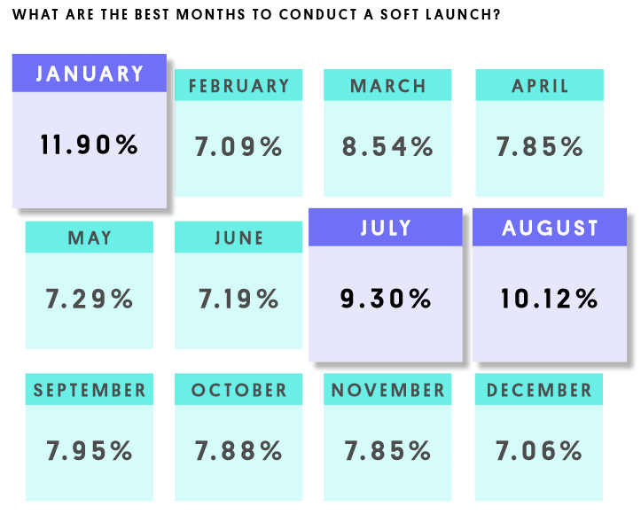
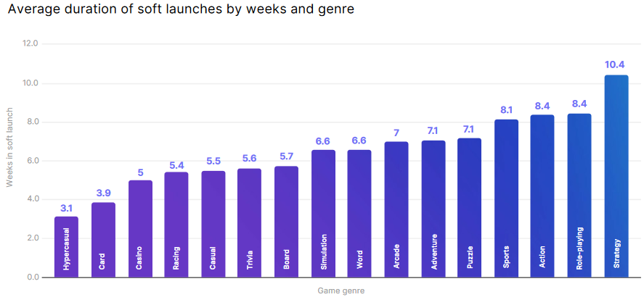
Market Potential - Optimal Soft & Main Launch
text
Notes:
Unity Mobile Insights 2022

Slide 12
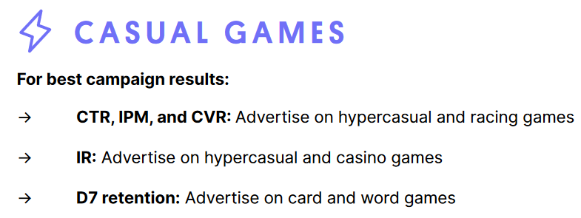
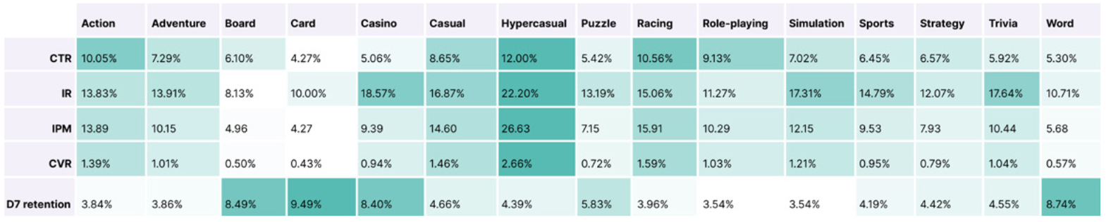
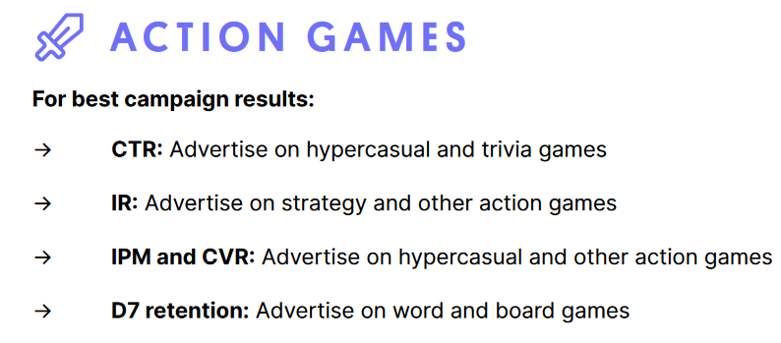
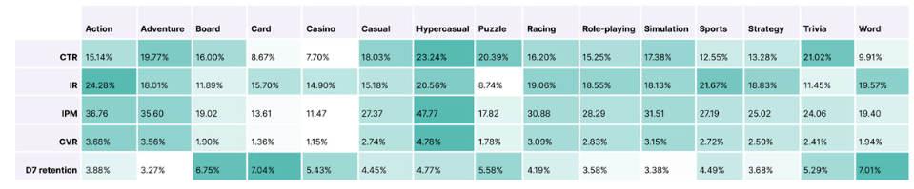
Market Potential - Ad Campaign
Notes:
Unity Mobile Insights 2022

Slide 13
Marketing Strategy
Website
Social media
Development blog - weekly updates
Planned features
Q&A
Weekly redeemable codes
Customer Support
Twitter
Facebook
TikTok
YouTube
Live streams
Expand on how – 2 slides
Trailer
Advertising
Gameplay footage
Mechanics highlight
Cosmetics showcase
Variety of advertisements
Sponsorships
Press kit for media

Slide 14
Engagement
Subtitle
Subtitle
Subtitle
text
This is content from “growth strategy”, rename other to “growth”, show and explain benefit to users, income etc from the engagement tactics
text

Slide 15
Growth Strategy
- Onboarding process for new users
No account required, but recommended and rewarded
Linking with socials rewarded, scaling rewards for inviting friends to the game
Reward multiple loot boxes that each take an amount of time to open for free
Targeted & tailored push notifications
Daily, weekly and monthly competitions
Seasonal events Halloween Christmas etc
Keep track of analytics to identify strong and weak areas

Slide 16
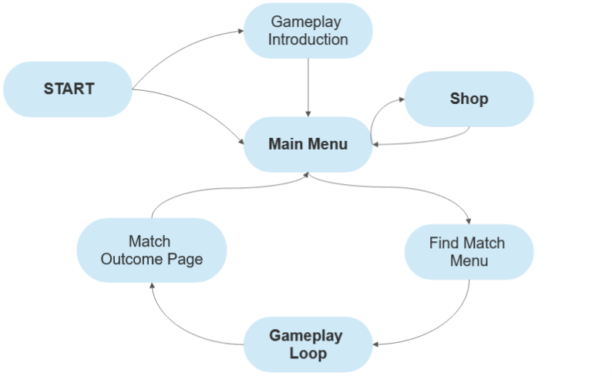
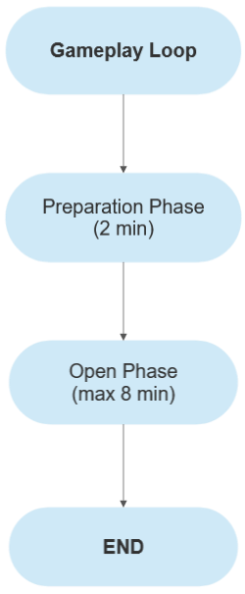
Application Loop

Slide 17
Short Example
Video showing main menu → finding game → lobby → starting game → basic movement, mining etc mechanics

Slide 18
Game Economy
Simplify
Silver Coins
Gold Coins
Loot Boxes
Cosmetic Fragments
Low amount rewarded from unranked match wins
Very low amount rewarded from unranked match missions
Moderate amount rewarded from ranked matches
Purchasable with Gold Coins
Low amount rewarded from ranked match wins
Very low amount rewarded from ranked match missions
Can be obtained through daily login rewards
Purchasable with money
Rarely awarded from ranked match wins
Can be obtained through daily login rewards
Purchasable with Gold Coins
Purchasable with money
Rarely awarded from ranked match wins
Can be obtained through daily login rewards
Low, moderate or high amount rewarded from respective Loot Boxes

Slide 19
Action Plan
Early January
Development planning, finalising design
Late January
Pre-production, early prototyping
February → July
Main production
August
Soft launch, feedback opportunity
September
Bug fixes and gameplay balance adjusted
October
Main release
Check over, final release in august, development time much shorter using more skilled freelancers for less time

Slide 20
Financial Traction
Use real examples for accuracy – avg for casual and stats for the games in competition slide
Account for new costs e.g. smaller team using freelancers for around 6 months – SPLIT INTO EACH JOB E.G. SOUND 2 MONTHS, ART 6 MONTHS, PROGRAMMING 5 MONTHS
0.9% of DAU make purchases
Year End | User Count | Retention Rate | Gross Income | Gross Cost | Net Profit
2023 | 300,000 | 5% | £48,000 | £95,000 | -£52,000
2024 | 500,000 | 4% | £128,000 | £145,000 | -£17,000
2025 | 625,000 | 3% | £228,000 | £185,000 | £43,000
2026 | 700,000 | 3% | £340,000 | £225,000 | £115,000

Slide 21
Revenue
 |  | 1 | 2 | 3 | 4
1
2
3
4
5
6
7
8
Use real examples for accuracy – avg for casual and stats for the games in competition slide
Split income and costs into as many categories as possible

Slide 22
Funding Required
How much money is required for each section – salaries, marketing, development costs e.g. licensing, server hosting
Title
text
Title
text
Title
text
Title
text
Title
text

Slide 23




Summary
How much I need, time scale for development, expected revenue costs profit, how long the loaned money + 20% will take to repay

Slide 24



Thank you
OutDig
Joe’s Games

